Slide 1

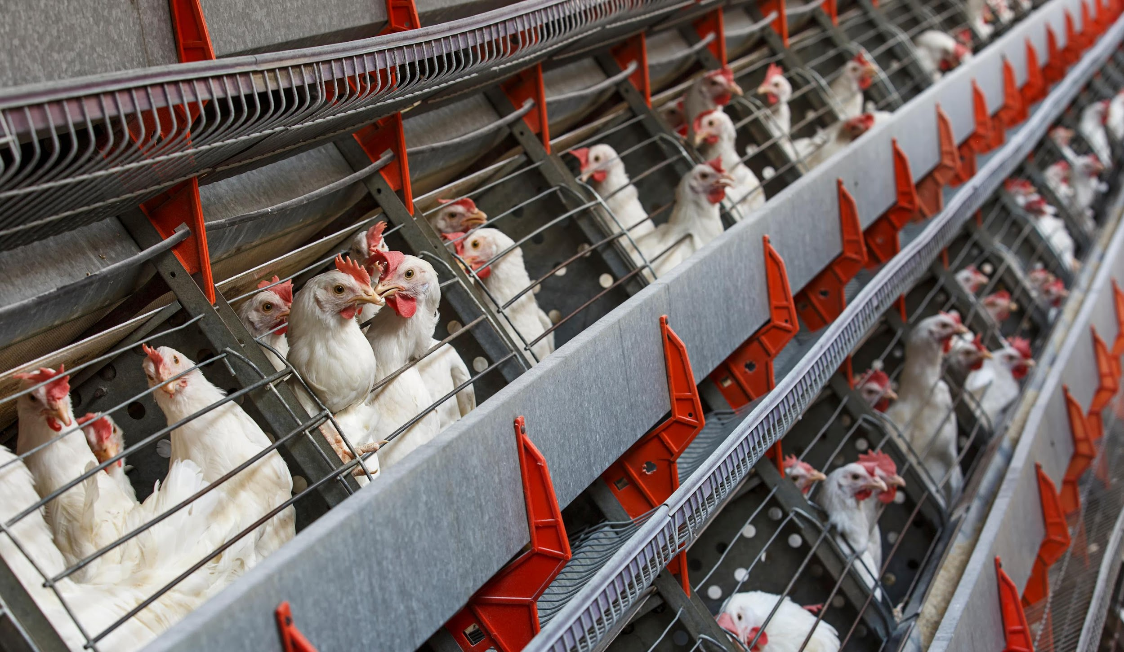

Smart Automation System for Controlling Environmental Parameters of Poultry Farms
Presentation by
Group Alpha
Ayesha Rahman
Tanjima Tahrin Khan
Arifur Rahman
Safayet Hossain Tanmoy
Sakib Nesar Ratul

Slide 2

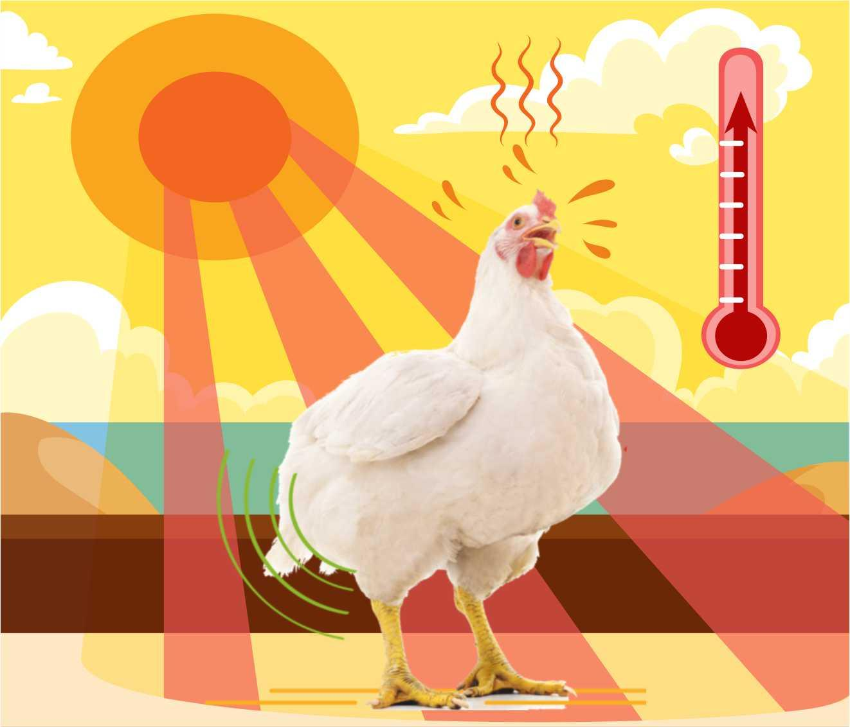
Problem Statement
High Mortality Rates Due to Poor Environmental Conditions
Lack of Efficient Monitoring and Data-Driven Management
Increased Costs Due to Inefficient Resource Usage
Health Issues in Poultry Due to Harmful Gases
Difficulty in Scaling Operations

Slide 3
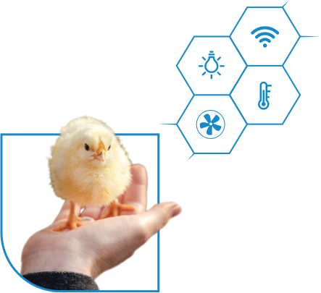
Abstract
The Smart Automation System for Controlling Environmental Parameters of Poultry Farms aims to automate the monitoring and regulation of key environmental factors like temperature, humidity, and air quality. This system uses microcontroller-based technology and sensors to ensure optimal conditions in poultry farms, reducing manual intervention while improving farm productivity and poultry health. By leveraging real-time data, the system can make informed adjustments to ventilation, heating, and cooling, enhancing poultry growth rates and minimizing energy costs.

Slide 4
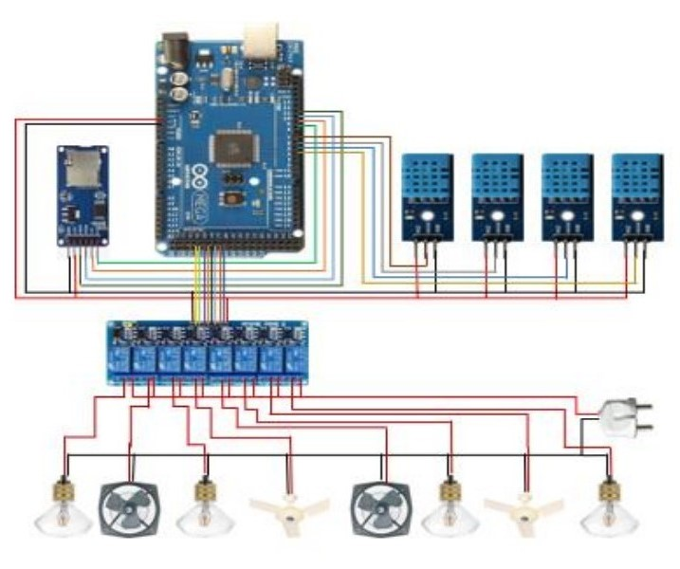
System Design
ESP32 Microcontroller: Central unit for data processing and control, equipped with Wi-Fi and Bluetooth for remote monitoring.
Environmental Sensors: DHT sensors for temperature and humidity, MQ sensors for detecting harmful gases.
Actuation Components: Relays and switches control cooling fans and heat bulbs based on sensor data.
Power Supply: 5V DC for control components and 220V AC for fans and bulbs.
Data Logging and Display: Real-time monitoring, data storage for analysis, and user interface display.

Slide 5
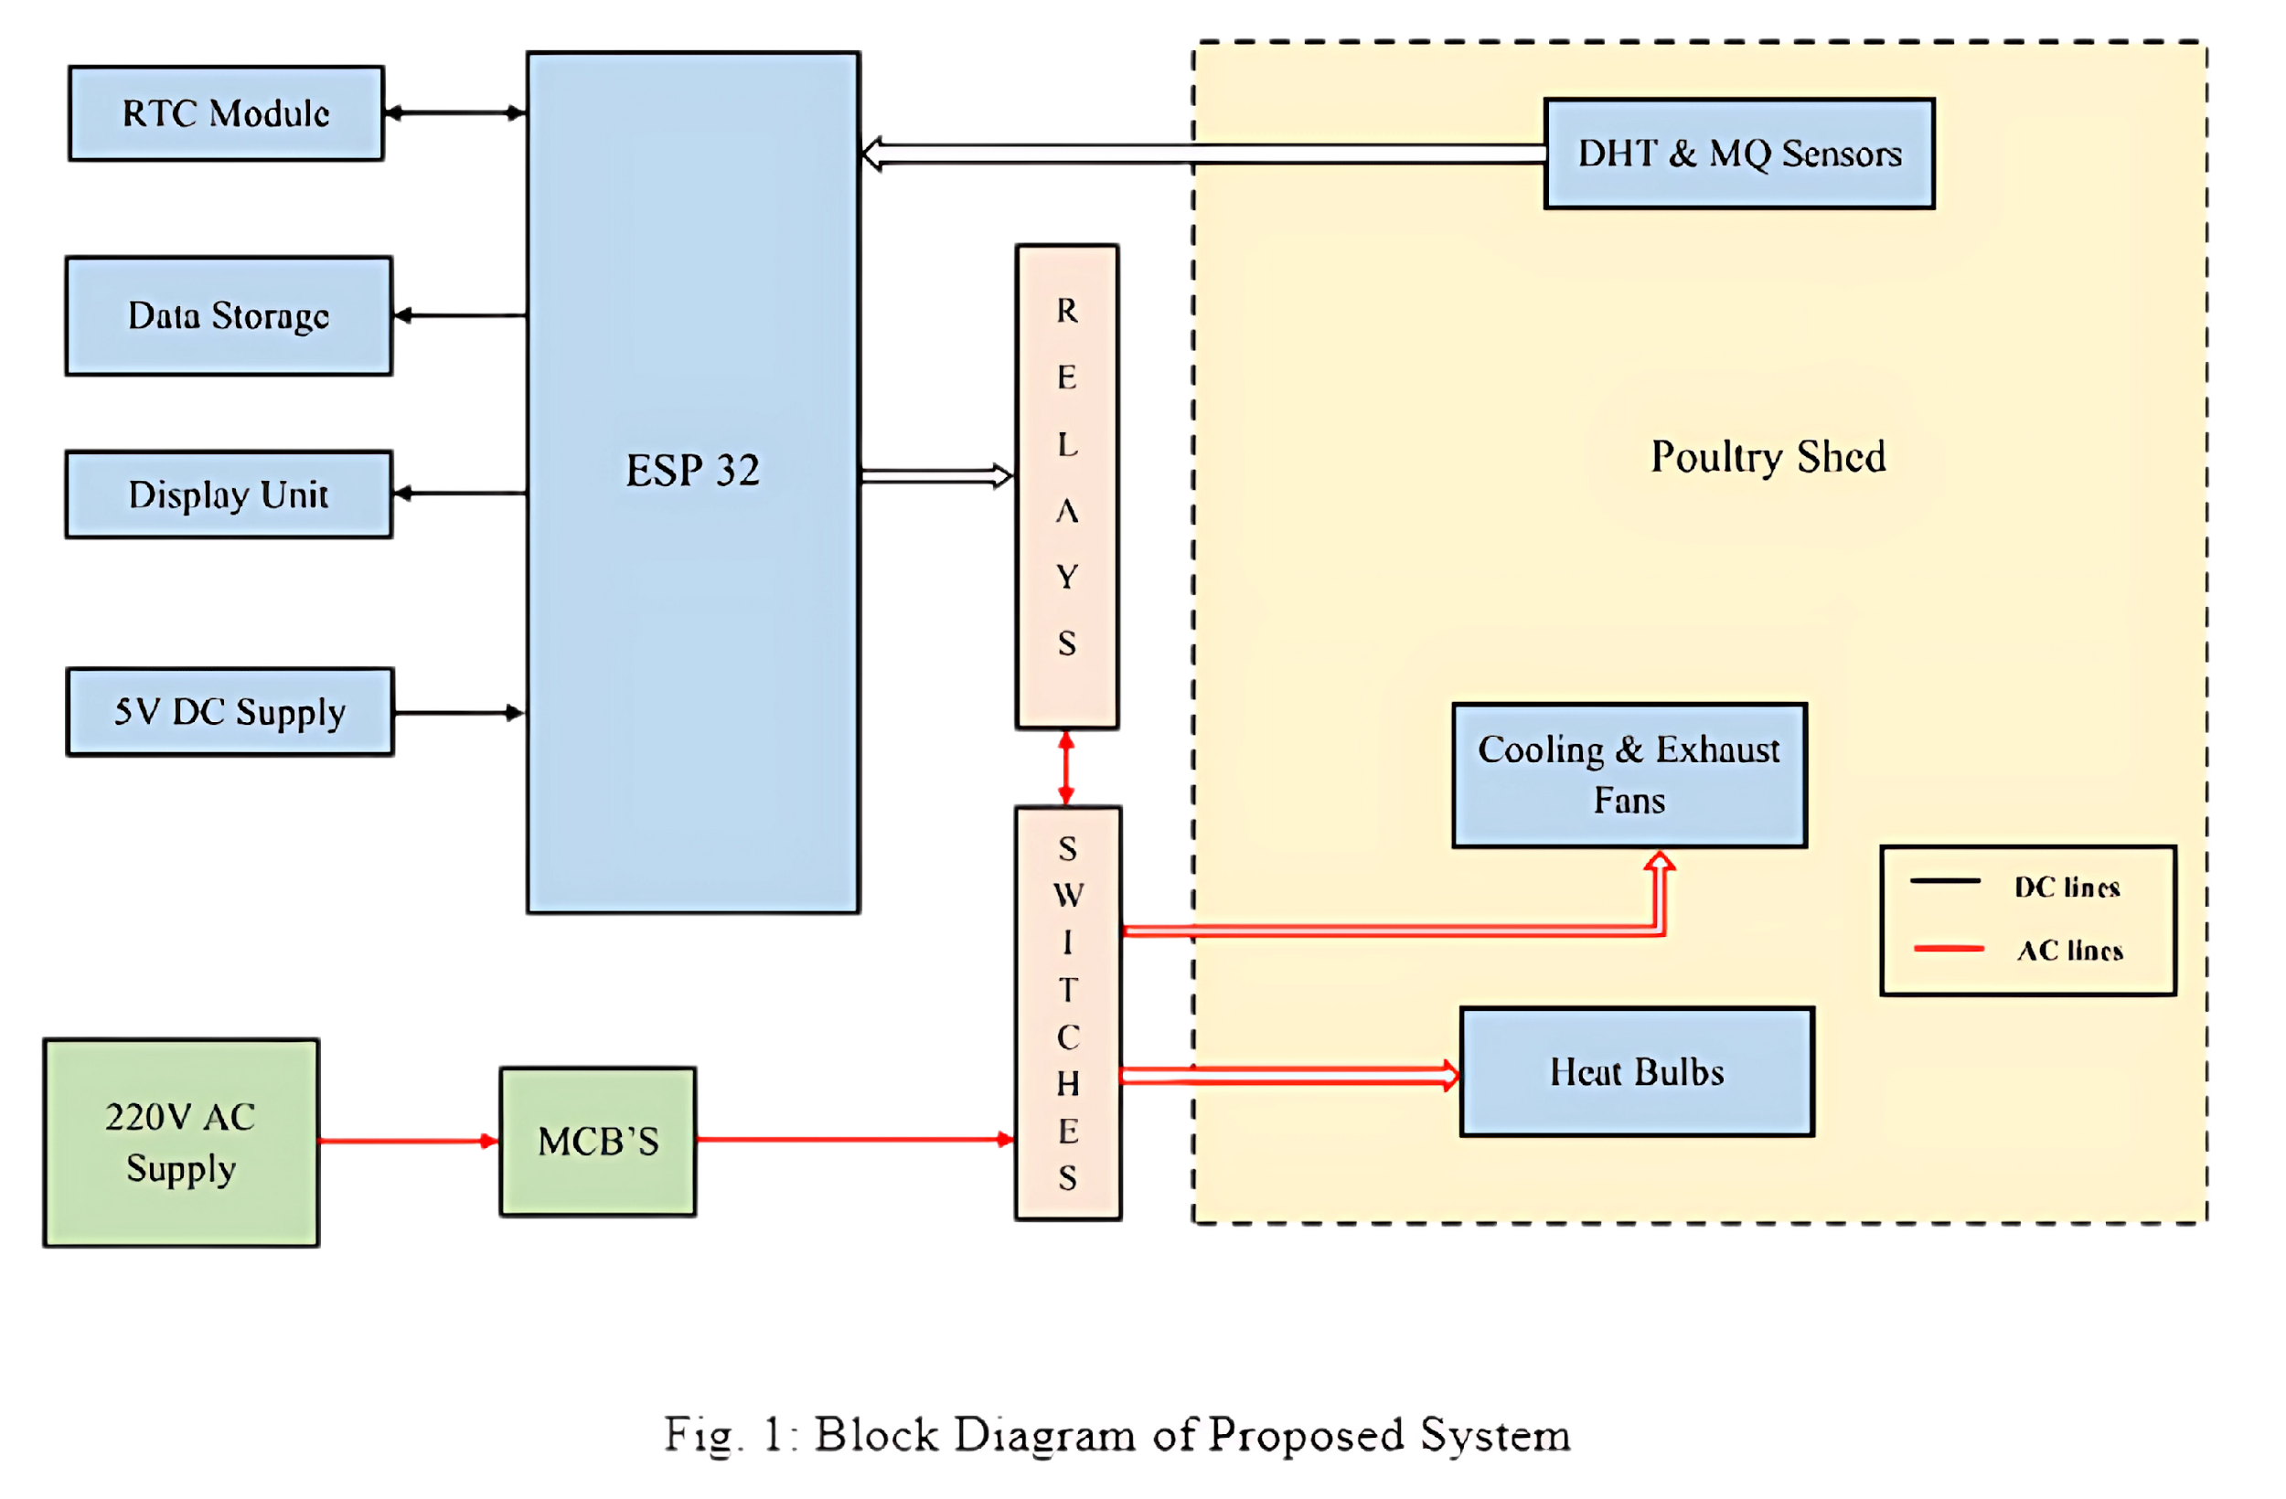
Block Diagram of Proposed System

Slide 6
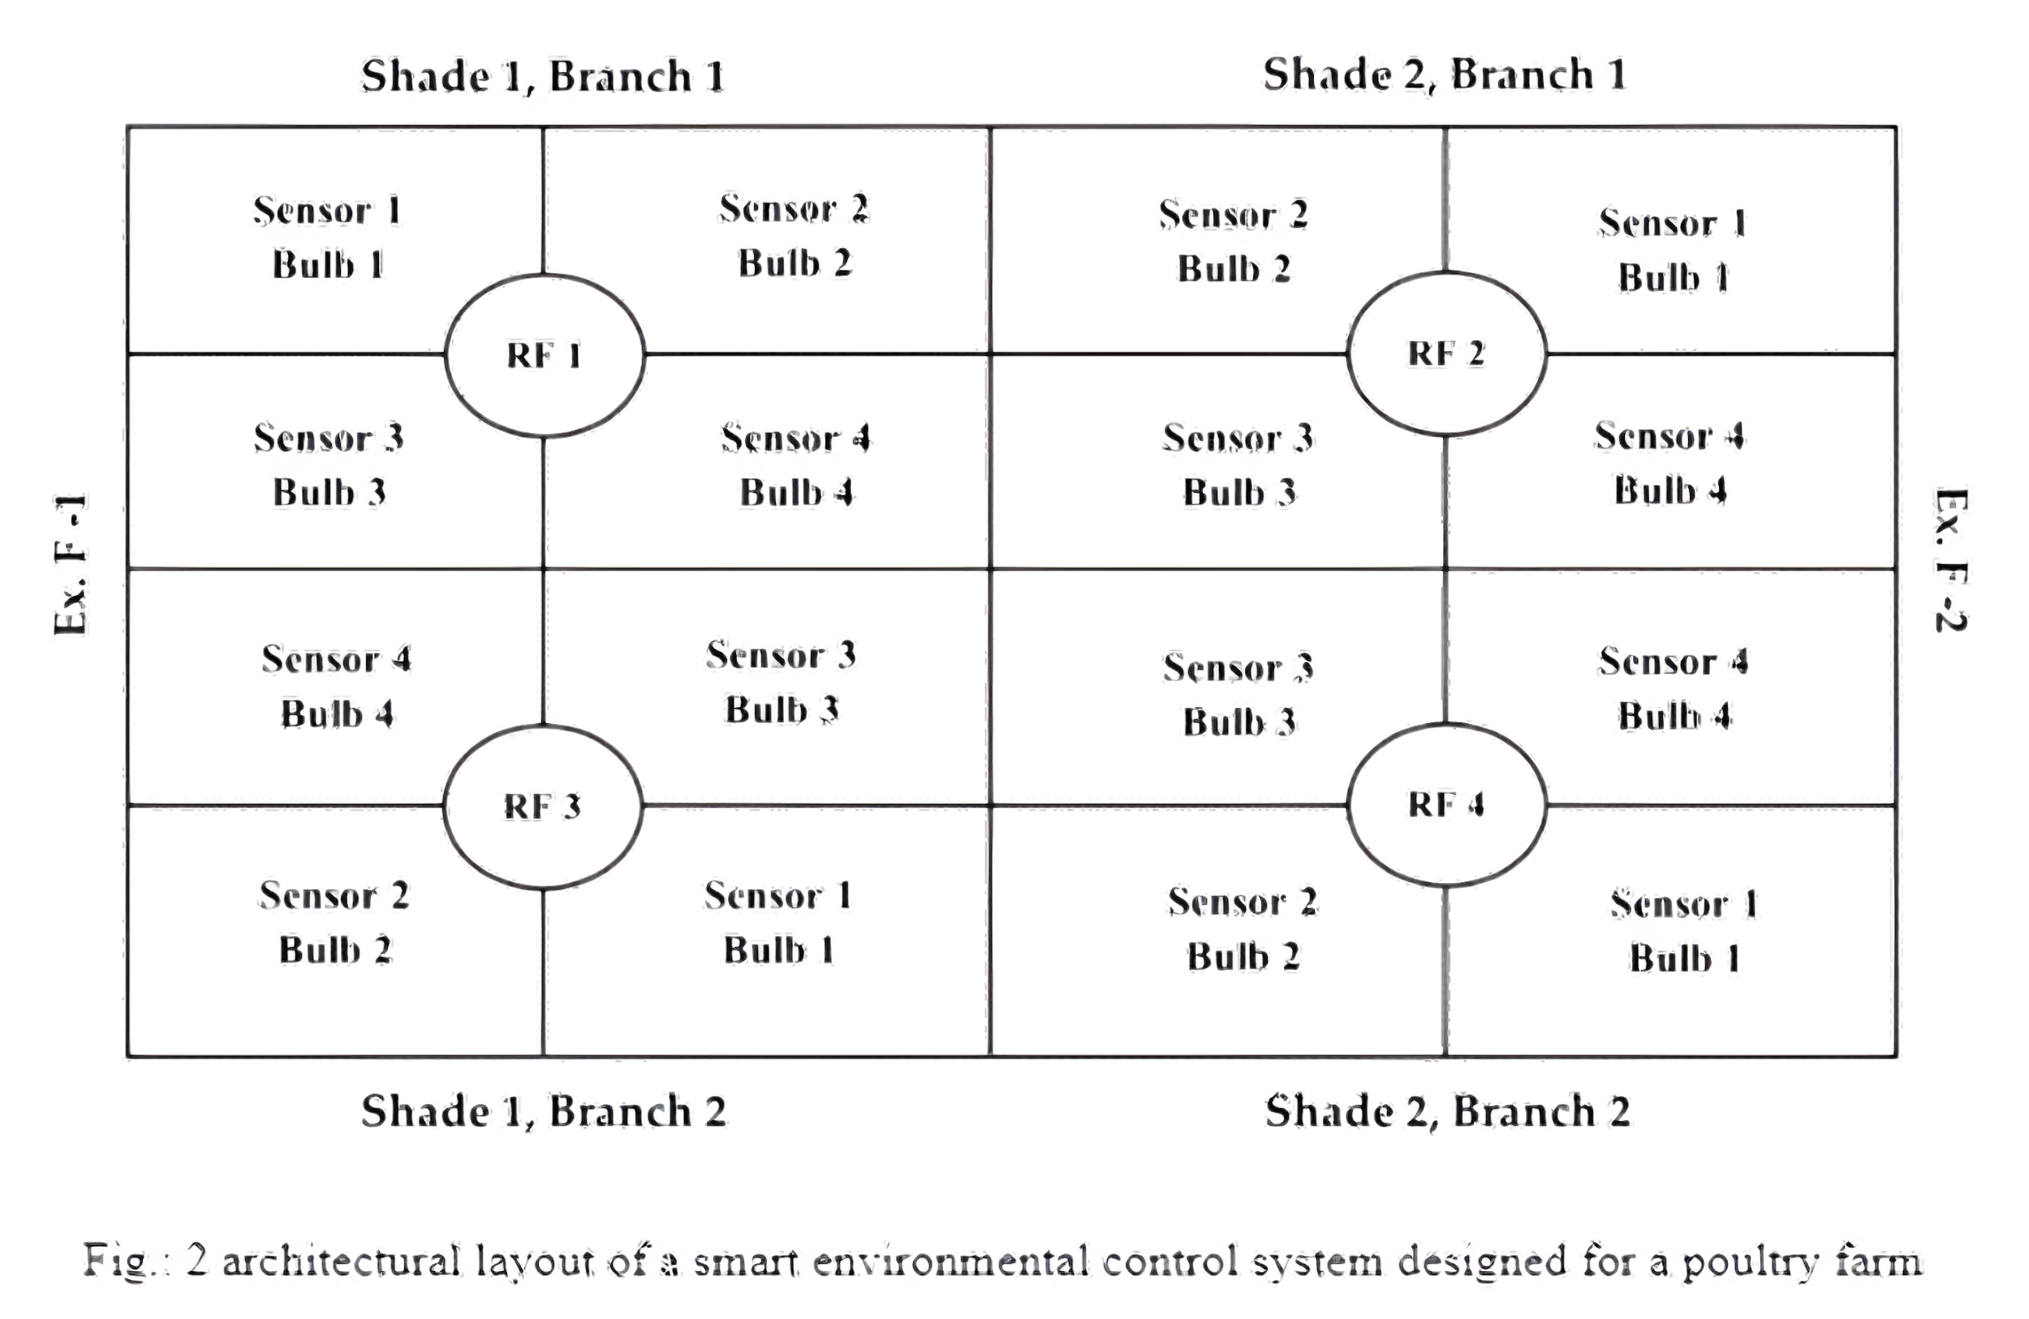
Implementation:
System Architecture and Layout Design

Slide 7
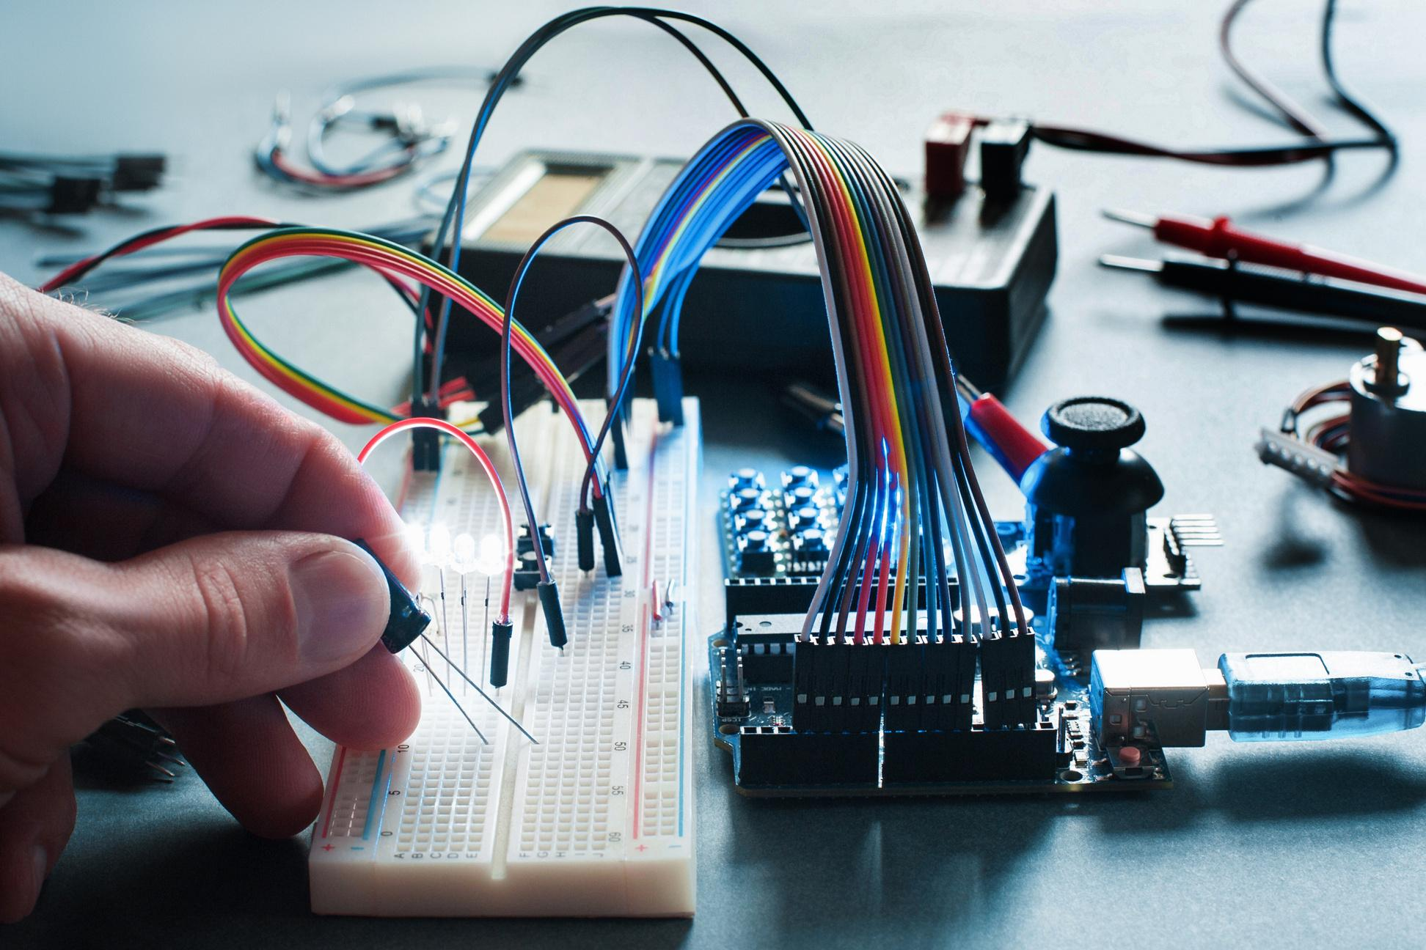
Hardware Components
ESP32 microcontroller for data processing and control.
DHT sensors for temperature and humidity monitoring.
MQ sensors for detecting ammonia and other harmful gases.
Relays and switches to control cooling fans and heat bulbs.
Real-Time Clock (RTC) for time-based control.
Software
The system processes sensor data using the ESP32 to activate heating or ventilation as needed.
Real-time data is logged and displayed for monitoring.
Internet of Things (IoT) capability for remote access and data storage in the cloud.

Slide 8
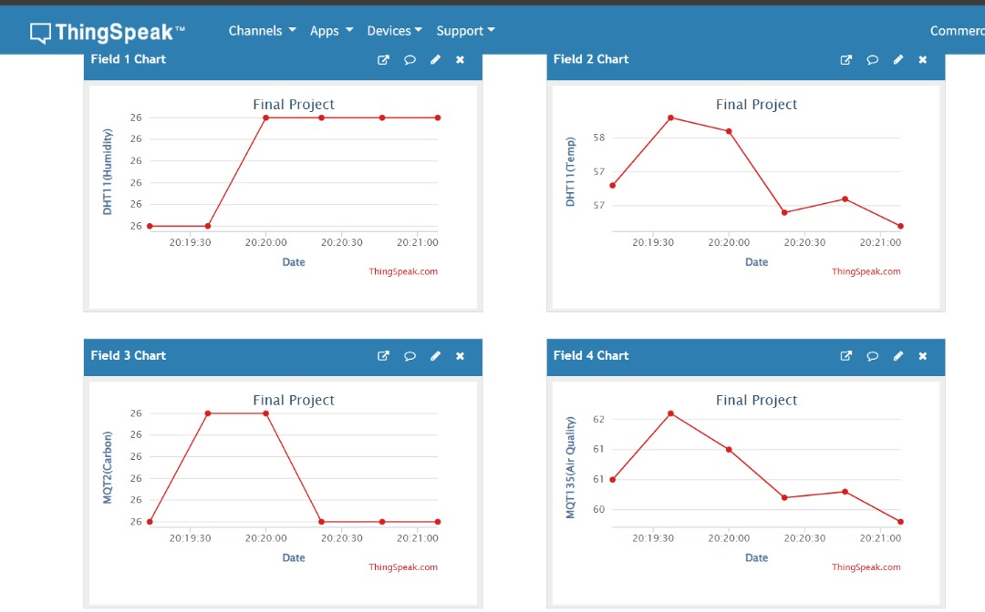
Result:
Result analysis using ThingSpeak

Slide 9

Results
Enhanced Poultry Health: Chickens are less prone to heat stress and respiratory illnesses, resulting in lower mortality rates and higher productivity.
Improved Efficiency: By automating environmental control, the system reduces energy and resource consumption, ensuring better feed conversion and growth rates.
Data-Driven Decisions: Historical data on environmental conditions allow farmers to optimize their farm management strategies.

Slide 10

Drawbacks
Reliance on Internet Connectivity: The system's IoT functions depend on stable internet, which may be a challenge in rural areas with poor connectivity.
Maintenance Requirements: Sensors and devices require regular maintenance and calibration to ensure accurate readings, increasing operational costs.
Learning Curve: Farmers unfamiliar with IoT and smart systems may face challenges in operating and maintaining the technology without adequate training.

Slide 11

Social Impact
Food Security: By increasing the supply of poultry products, the system helps combat protein deficiencies in developing countries, improving nutrition.
Economic Empowerment: Automation reduces operational costs, allowing farmers to increase profitability and expand their businesses, thus contributing to rural economic development.
Sustainability and Climate Resilience: The system optimizes energy usage and reduces waste, aligning with climate resilience efforts and promoting sustainable farming practices.
Community Development: Improved farm profitability leads to better livelihoods for farm workers and their families, contributing to social stability and growth in rural areas.

Slide 12
Reference
1. Scanes CG (2007) Contribution of poultry to quality of life and economic development in the developing world. Poult Sci 86(11):2289–2290
2. Emery J (2004) Heat stress in poultry solving the problem. Defra Publications, Department for Environment, Food and Rural Affairs London, UK (2004)
3. Corkery G, Ward S, Kenny C, Hemmingway P (2013) Monitoring environmental parameters
in poultry production facilities. In: Computer aided process engineering forum. Institute for
Process and Particle Engineering, Graz University of Technology, Austria
4. Rimoldi S, Lasagna E, Sarti FM, Marelli SP, Cozzi MC, Bernardini G, Terova G (2015) Expression profile of six stress-related genes and productive performances of fast and slow growing
broiler strains reared under heat stress conditions. Meta Gene 6:17–25
5. Oguntunji AO, Alabi OM (2010) Influence of high environmental temperature on egg
production and shell quality: a review. Worlds Poult Sci J 66(4):739–750

Slide 13
Reference
6. Mutai EBK, Otieno PO, Gitau AN, Mbuge DO, Mutuli DA (2011) Simulation of the
microclimate in poultry structures in Kenya. Res J Appl Sci Eng Technol 3(7):579–588
7. British Standards Institution (1990) BS 5502: Part 43: Code of practise for design and
construction of poultry buildings, London, UK
8. Meluzzi A, Sirri F (2009) Welfare of broiler chickens. Ital J Anima Sci 8(1):161–173
9. University of Kentucky: factors affecting broiler performance (2010)
10. Fairchild BD (2009) Environmental factors to control when brooding chicks. Technical bulletin
1287, cooperative extension service. University of Georgia, GA
11. Mahale RB, Sonavane SS (2016) Smart poultry farm monitoring using IOT and wireless sensor
networks. Int J Adv Res Comput Sci 7(3)

Slide 14
Reference
12. Ahmadi MR, Hussien NA, Smaisim GF, Falai NM (2018) A survey of smart control system
for poultry farm techniques. Int J Distrib Comput High Perform Comput
13. Lahlouh I, Rerhrhaye F, Elakkary A, Sefiani N (2020) Experimental implementation of a new
multi input multi output fuzzy-PID controller in a poultry house system. Heliyon 6(8):e04645
14. Alimuddin KBS, Subrata BS, Sumiati NN (2011) A supervisory control system for temperature
and humidity in a closed house model for broilers. Int J Electr Comput Sci 11:75–82
15. Paputungan V, Faruq A, Puspasari F, Hakim F, Fahrurrozi I, Oktiawati UY, Mutakhiroh I (2020)
Temperature and humidity monitoring system in broiler poultry farm. In: IOP conferences on
series: materials science and engineering, vol 803, p 012010
16. Wariston FP, Fonsecac LS, Fernando BCG, Luciana (2020) Environmental monitoring in
a poultry farm using an instrument developed with the internet of things concept. Comput
Electron Agric 170:105257

Slide 15
Code Link
https://github.com/SakibRatul/Smart-Automation-System-for-Controlling-Environmental-Parameters-of-Poultry-Farms

Slide 16
Thank You!

